Slide 1
ONLINE RETAIL ANALYSIS
TEAM 6
Himaja VADAGA
SANDEEP BETHI
BRYCE BRAKO

Slide 2
DATASET
Transactional dataset of a UK based E-commerce company
Source: UCI machine learning repository
Size: Eight features and 541909 rows
Features are of both categorical and numeric format
Major challenges: Establishing the scope of the analysis, defining and deriving the business value of analysis, cleansing and pre-processing of dataset

Slide 3
NOISY AND BAD DATA
The “Description” column had a missing value count of 1501.
The “CustomerID” column had a missing value count of 135080.
The “Quantity” column had negative values in it.
The “Unit Price” column had negative values in it
The columns Unit Price and Quantity had outliers
Not many feature present to do better analysis so need to perform feature engineering on Date column
Performed feature selection module before building the models
The values in Description and Country features were having spaces between the words. This could effect the output while parsing the input and deploying the web application

Slide 4
Algorithms DEPLOYED
Recommendation: Match Box recommender
Combination of content based and collaborative filtering
Classification: Two-class logistic regression
Two-Class Average Perception
Two-class support vector machine(SVM)
Two-class Bayern point machine
Prediction: Poisson Regression
Linear Regression
Neural Network Regression
Decision Forest Regression
Boosted Decision Tree Regression
CHOSE ONE BEST MODEL FROM CLASSIFICATION AND PREDICTION BASED ON PERFORMANCE METRICS EVALUATION

Slide 5
BUSINESS VALUE
Recommendation: Company can recommend appropriate products to specific customers. Increases the revenue of the company
Classification: By classifying whether a product is a good contributor or a bad contributor to the overall sales, the company can take measures and decide whether to continue selling that particular product or not
Prediction: By predicting the sales of the product by country and time, the company can take good measures in beforehand to allocate proper resources so that they can achieve their goals. They can also design their marketing strategy of different products in a better way

Slide 6
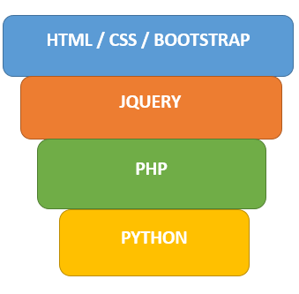
WEBSITE
The process flow design can be depicted as:
Overall Technologies used: Azure ML Studio, Power BI, R, HTML, CSS, Bootstrap, Python, Javascript

Slide 7
DEMO
CLICK HERE FOR DEMO
LINK: http://ecomm-analytics.azurewebsites.net/ecomm/index.php
Login Credentials for the website:
Username – ADSsummer2016Team6@outlook.com
Password – himajasandeepbryce@6
Login Credentials for Machine Learning Studio:
Username – bethisandeepkumar@gmail.com
Password – Sunrisers1$

Slide 8
FUTURE Prospects: K-means CLUSTERING
RFM (recency, frequency, monetary) analysis is a marketing technique used to determine quantitatively which customers are the best ones by examining how recently a customer has purchased (recency), how often they purchase (frequency), and how much the customer spends (monetary).
CustomerID, InvoiceDate and Sales_Amount
Lower the recency, high frequency and high monetary -> good customer
Interesting insight: the relationship between frequency and monetary seems to be a monotonic linear relationship.

